Slide 1


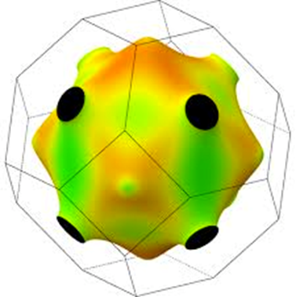
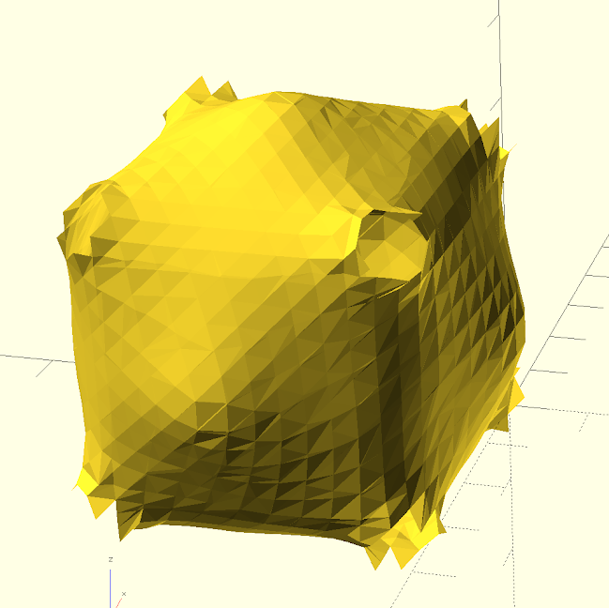
Generalizing Firmi:
Code to 3D-print Fermi Surfaces
Brian Hungerman
David Strubbe

Slide 2
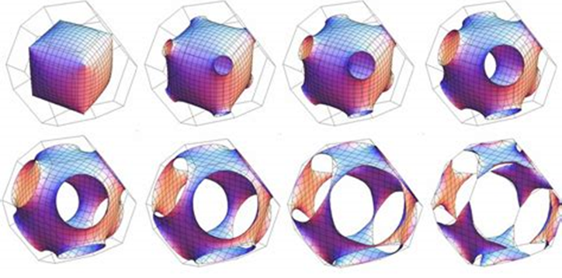
Fermi Surfaces: why do we care?
“a surface in momentum space enclosing all the occupied electronic states”
Useful for:
Conductivity/superconductivity
Many-body physics
Firmi (http://faculty.ucmerced.edu/dstrubbe/Firmi/) offers a unique hands-on teaching tool.

Slide 3
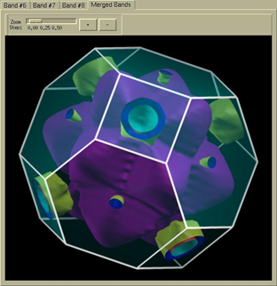
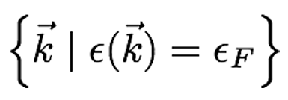
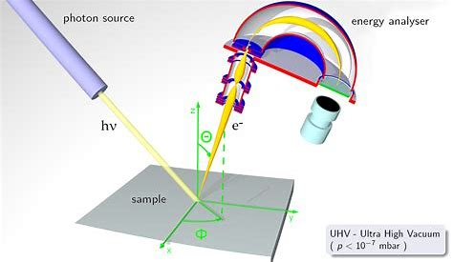
Fermi Surfaces: how we derive them
Theoretical:
Calculations of electronic structure
Experimentally:
-ARPES
-de Haas-van Alphen effect http://frimat.unifr.ch/
Conventional visualizations of these 3D surfaces can be abstract and unwieldy

Slide 4
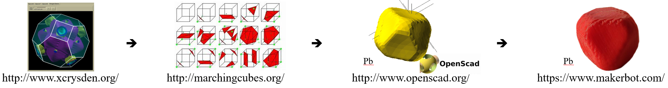
Firmi: using 3D-printing to visualize
Method:
Download band structure file, containing 3D matrix of electron energies
Employ Marching Cubes interpolation to form a polygonal isosurface
Open resulting file in any computer-aided design software, and print

Slide 5
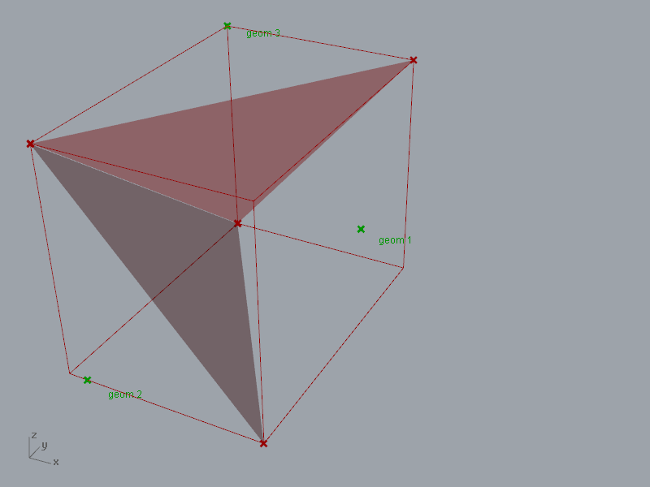
Firmi: interpolation
Fortran to implement Marching Cubes
Defining polygons between points of
matrix that span between energies
above and below a set “fermi energy”
Grasshopper3D.com

Slide 6
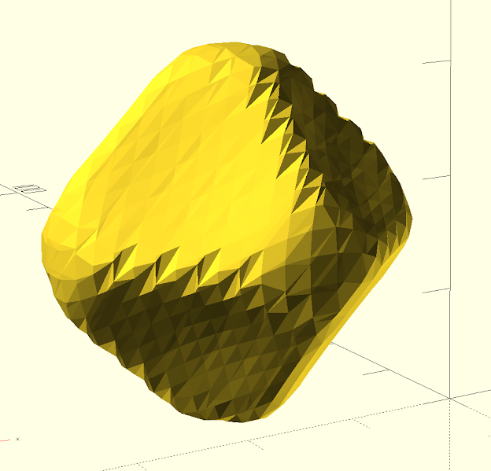
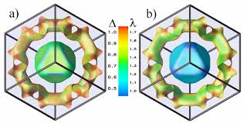
Firmi: interpolation
Results:
~
https://www.researchgate.net/ Pb

Slide 7
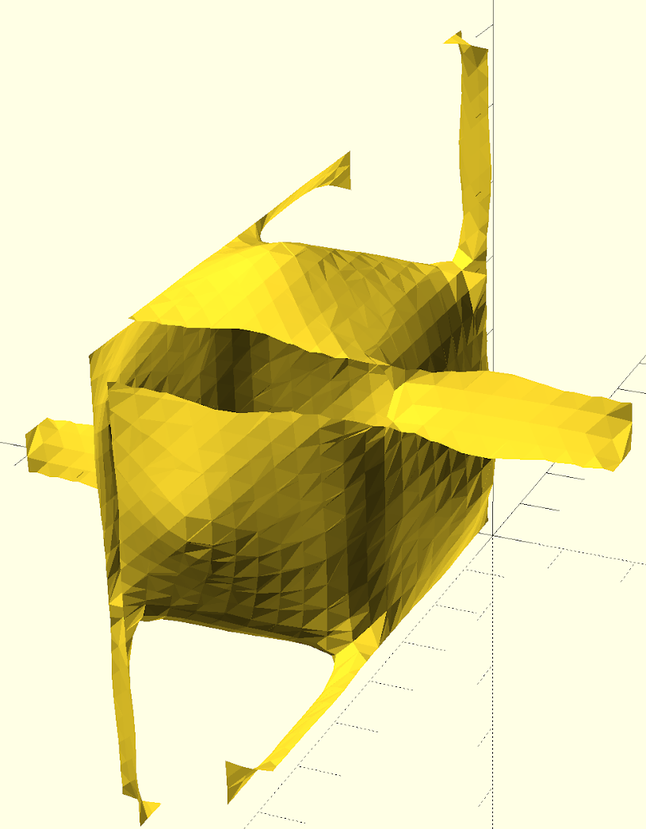
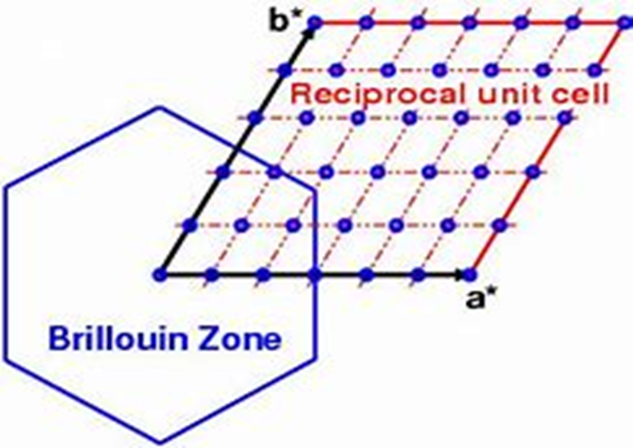
Firmi: interpolation
Defining the Brillouin Zone to
reassemble exploded isosurfaces:
Cu

Slide 8
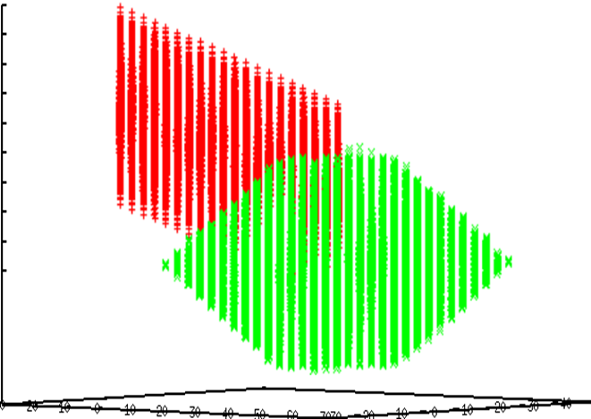
Firmi: interpolation
Results:

Slide 9
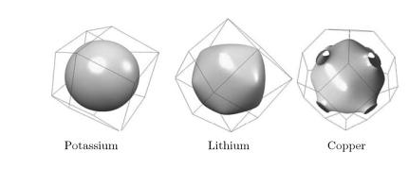
Firmi: interpolation
Capping ends of surfaces that lie on surface of Brillouin Zone:

Slide 10
Firmi: interpolation
Results:
TBD

Slide 11
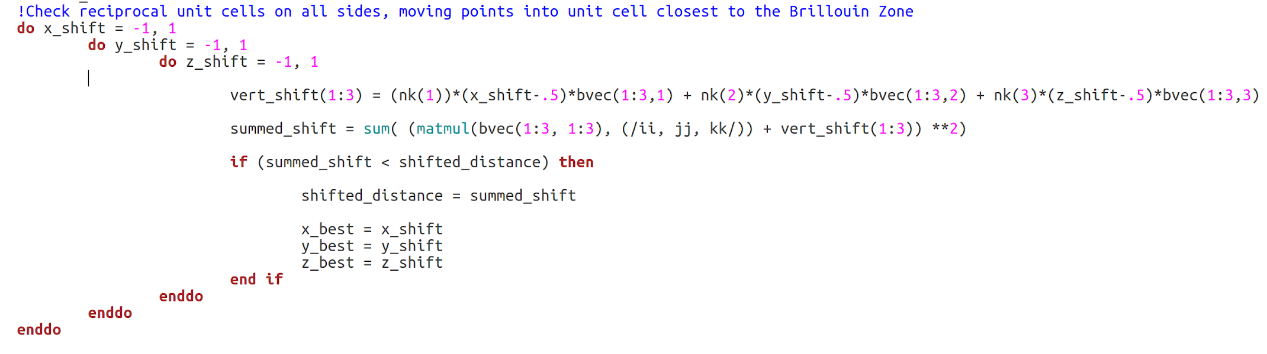
Firmi: interpolation
A taste of the code:

Slide 12
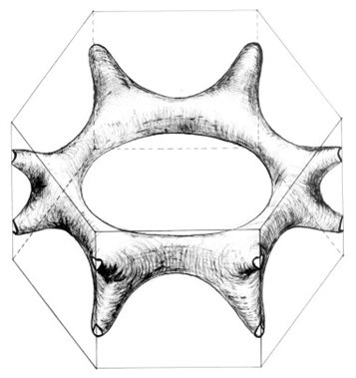
Firmi: future endeavours
Ensuring the program works for a wider array of metals (such as Mg [right]) and edge cases (such as selecting which band to plot).

Slide 13

Acknowledgements
Support from MACES – Merced NAnomaterials Center for Energy and Sensing (NASA funded)
3D-printer access from UC Merced Venture Lab

